Slide 1





Project Title :
Account Receivables and Collections in Oracle ERP

Slide 2

Track: Oracle Digital Accounting Specialist
Group Code: NXT26_ONL2_ERP4_S3

Slide 3
Team Members :
1.Mohamed Soltan Abdelzaher Hussein
2.Ibrahim Gaber Ismail Metwaly
3.Moaz Awad Sobhy Mohamed
4.Mohamed Swiefy Abd Elhamied Swiefy
5.Mennatallah Ismail Ahmed Dawood
6.Naira Mohamed Ahmed Attia

Slide 4
Oracle EBS Financials Modules
1-General Ledger (GL)
2-Account Payable (AP)
3- Account Receivable (AR)
4-Fixed Assets (FA)
5-Cash Management (CM)

Slide 5
Objective :
To equip users with the skills to manage customer invoices, record payments, generate financial reports, and complete period-end closing activities efficiently using the Accounts Receivable module in Oracle ERP

Slide 6
Content:
1
General Ledger
2
Accounts Receivable

Slide 7
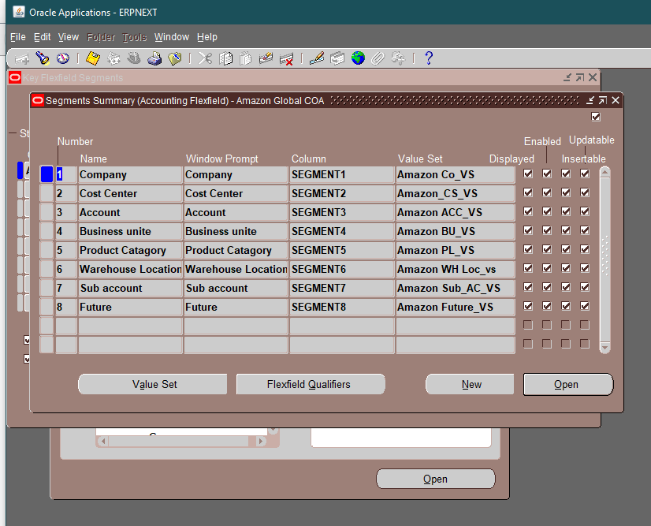
1
General Ledger
1-Segments

Slide 8
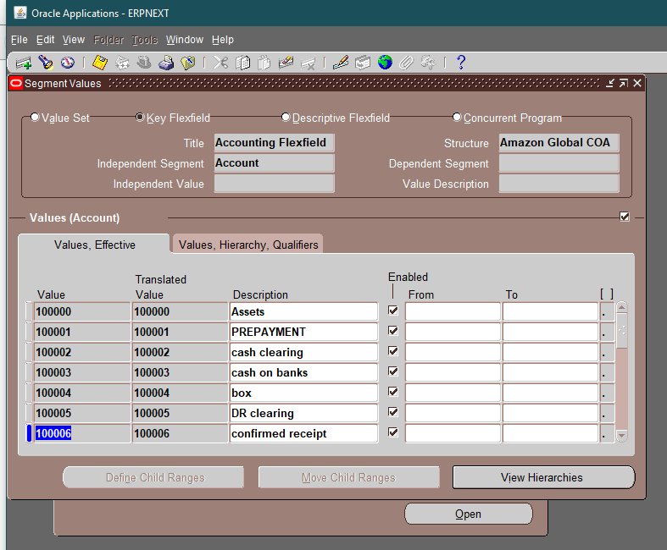
2-Segment Value Sets

Slide 9
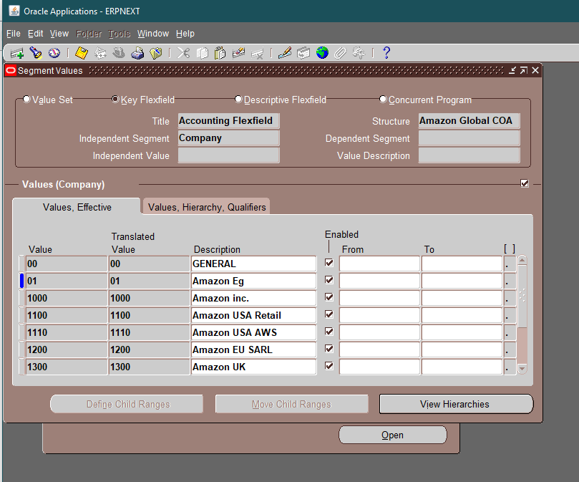

Slide 10
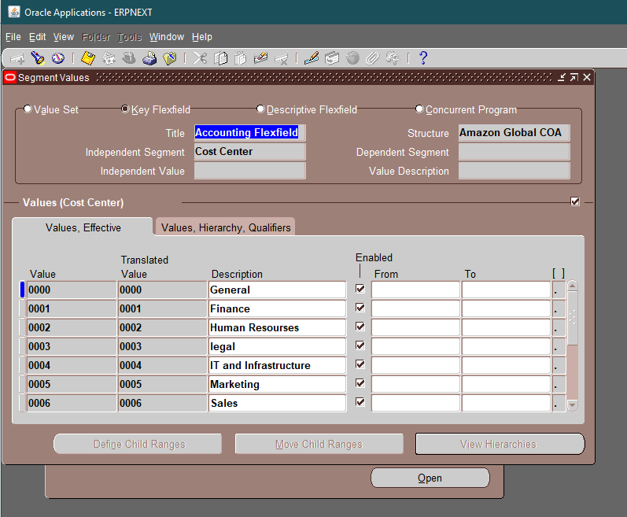

Slide 11
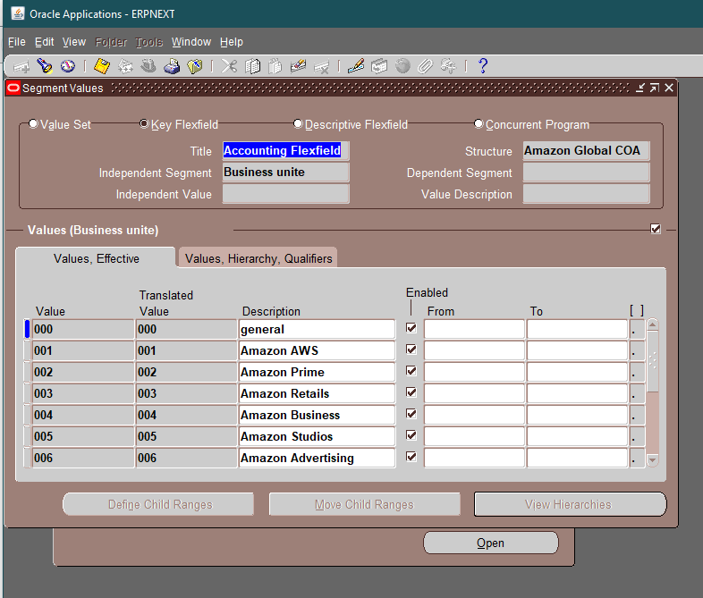

Slide 12


Slide 13
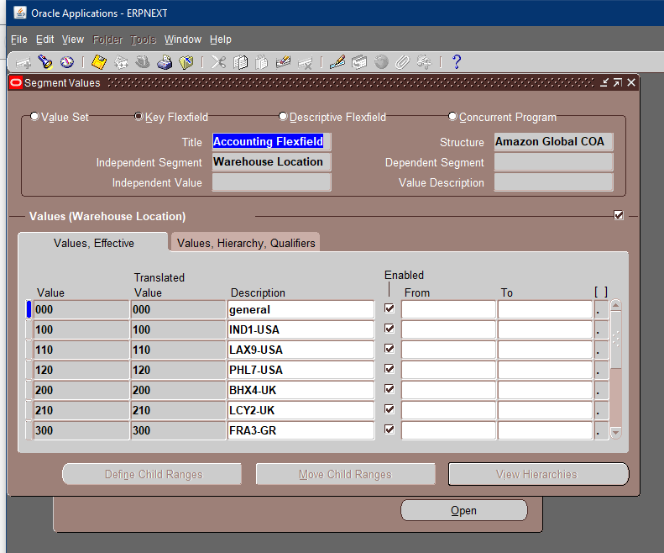

Slide 14
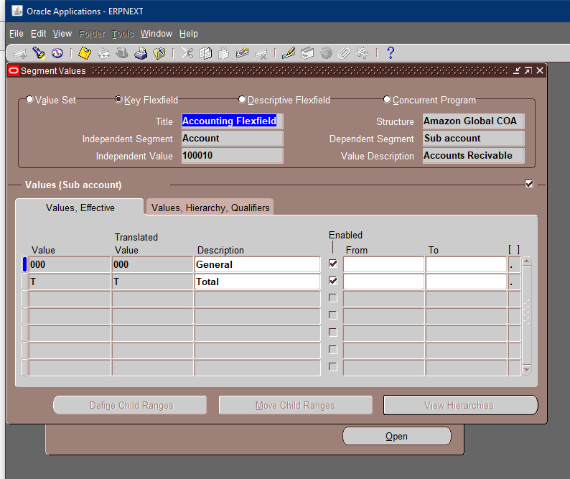

Slide 15
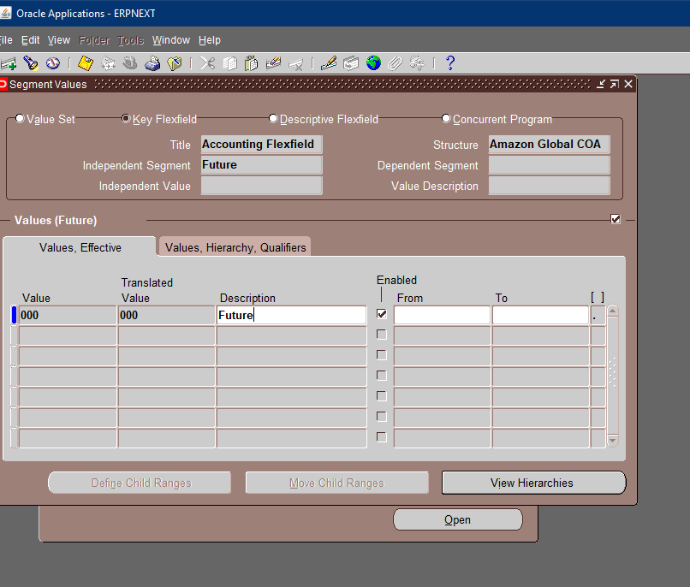

Slide 16
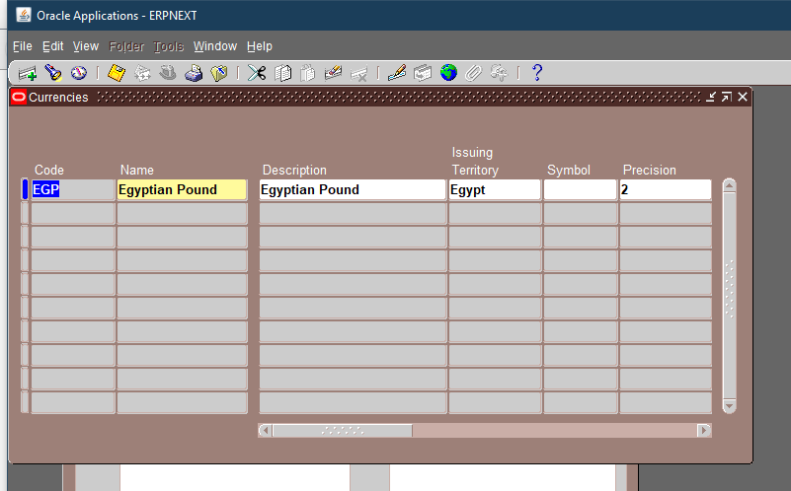
3-Currency

Slide 17
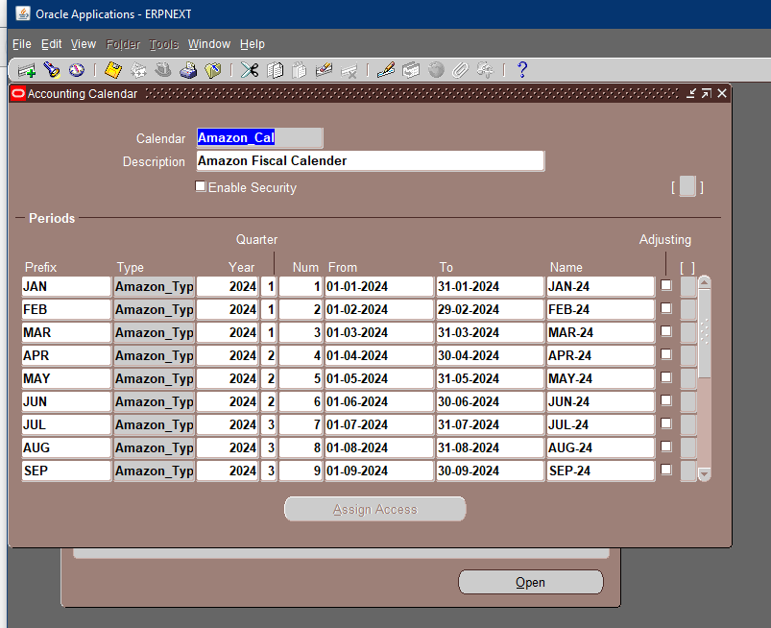
4-Calander

Slide 18
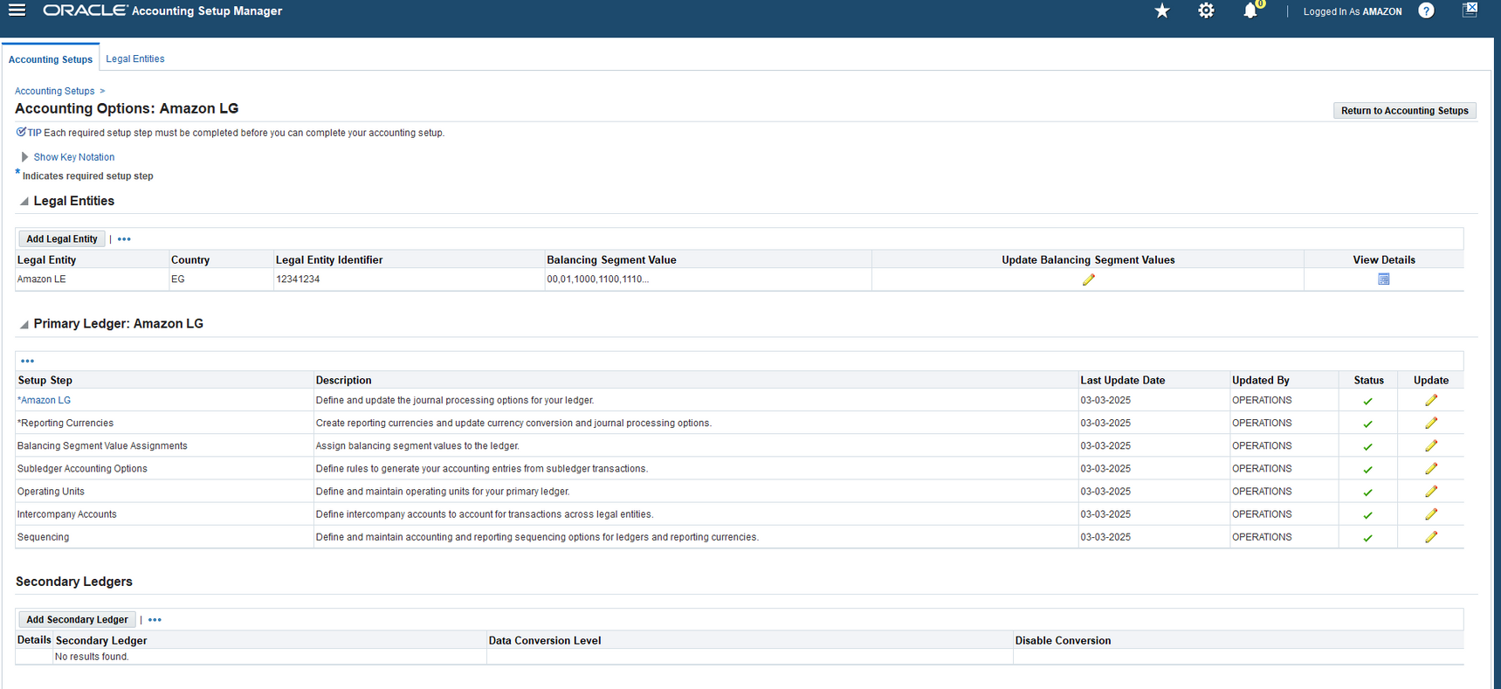
Account Setup Manager

Slide 19
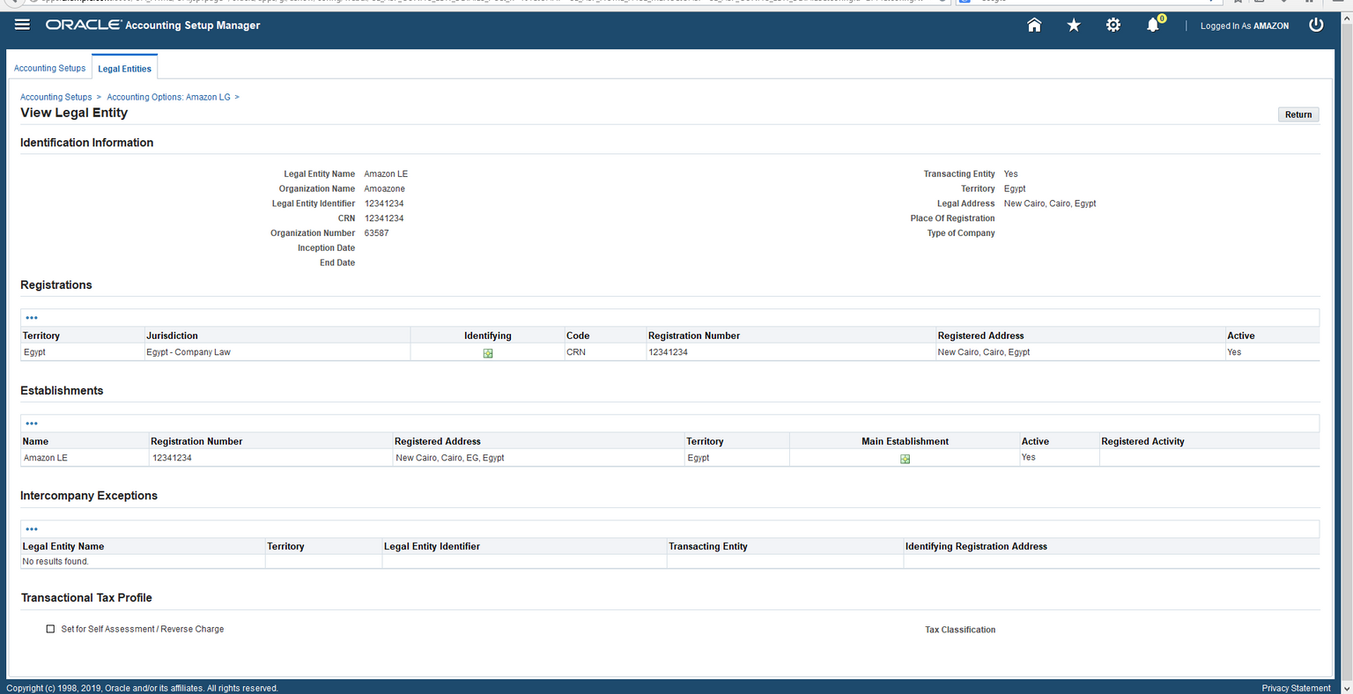
Legal Entity

Slide 20
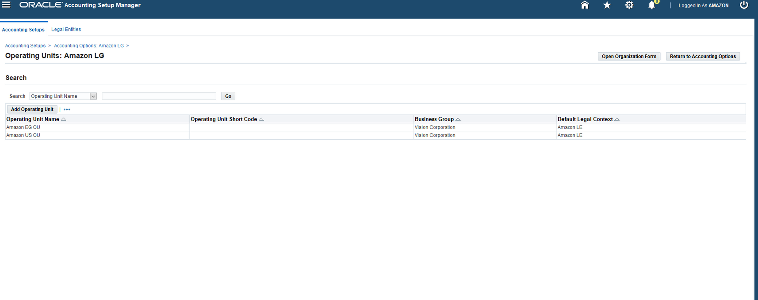
Operating Units

Slide 21
2
Accounts Receivables
system option
autoAccounting
Bank Setup
memo line
Transaction Type
source
customer
receivable activities
receipt method
create Accounting report
create receipt
create transaction

Slide 22
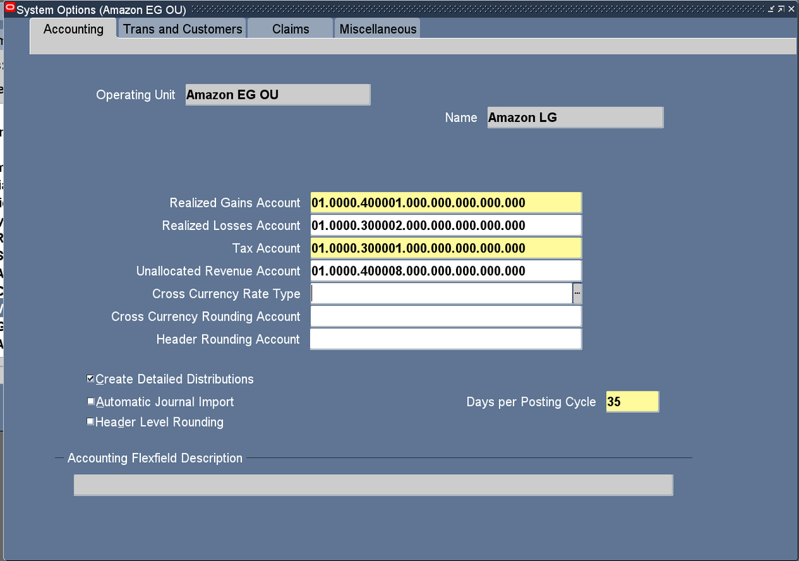
System Options :
Setup >> System >> System Options

Slide 23
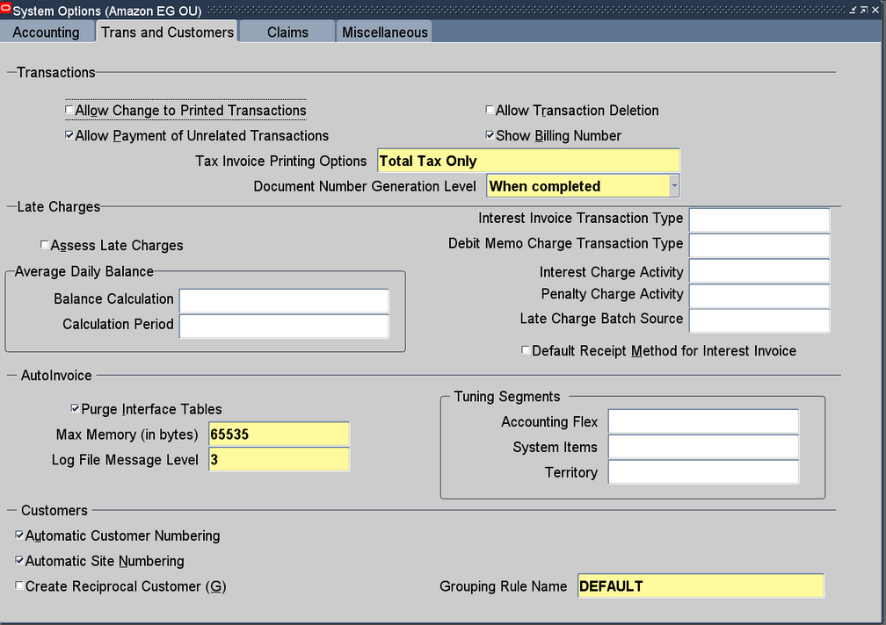
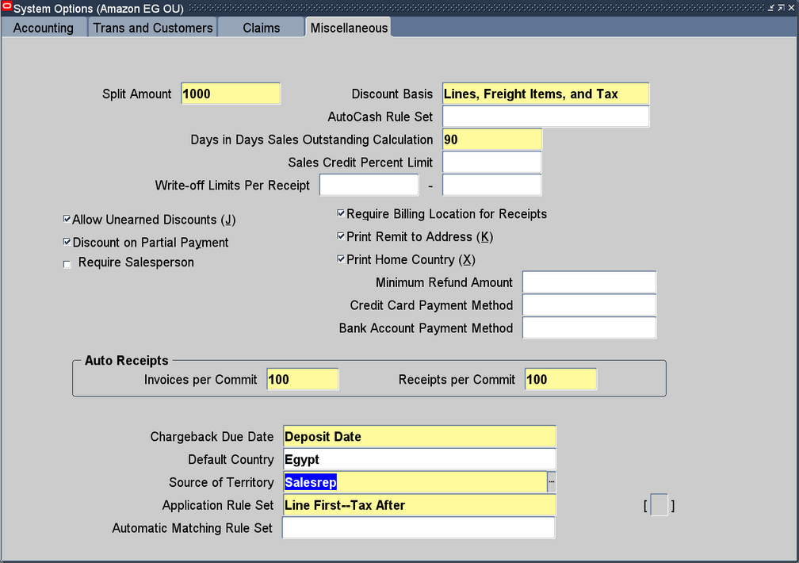

Slide 24
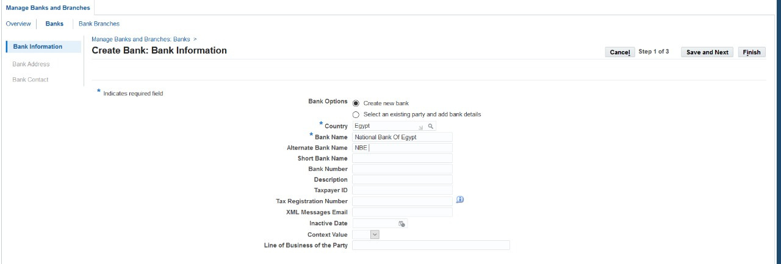
Bank Setup : Bank
AP Responsibility >> Setup >> Payment >> Bank And Bank Branches

Slide 25
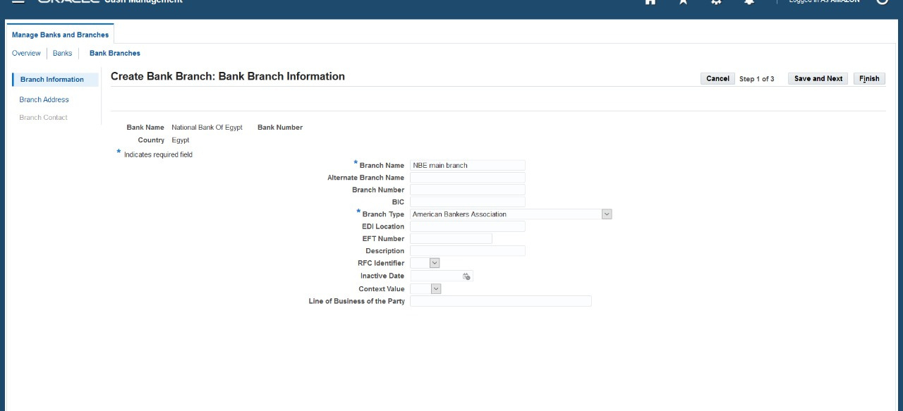
Bank Setup : Bank Branch

Slide 26
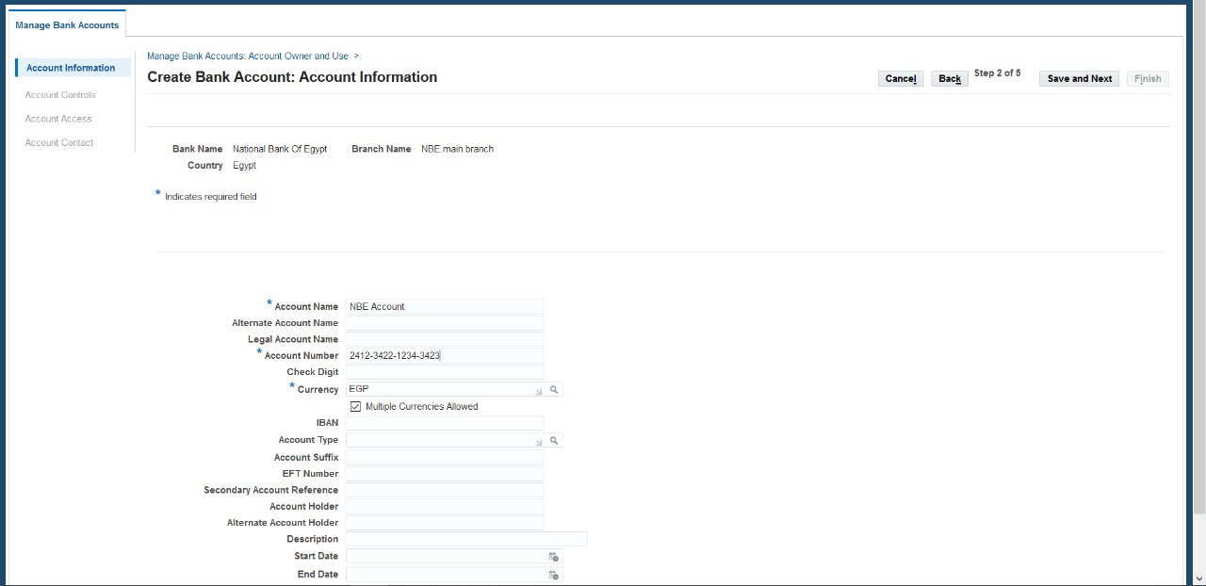
Bank Setup : Bank Accounts
AP Responsibility >> Setup >> Payment >> Bank Accounts

Slide 27
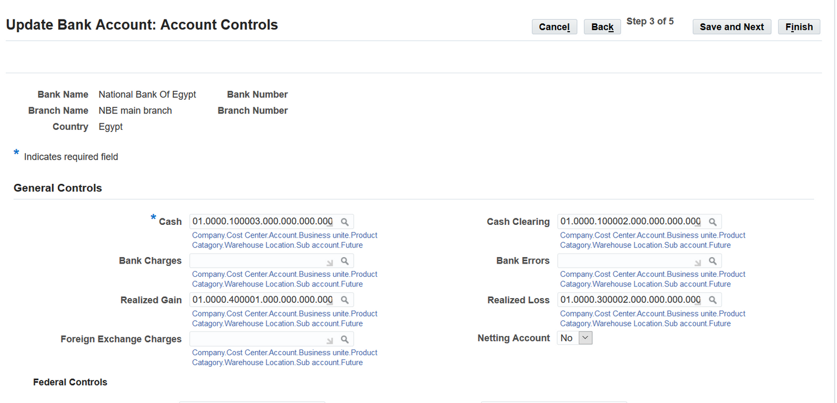

Slide 28
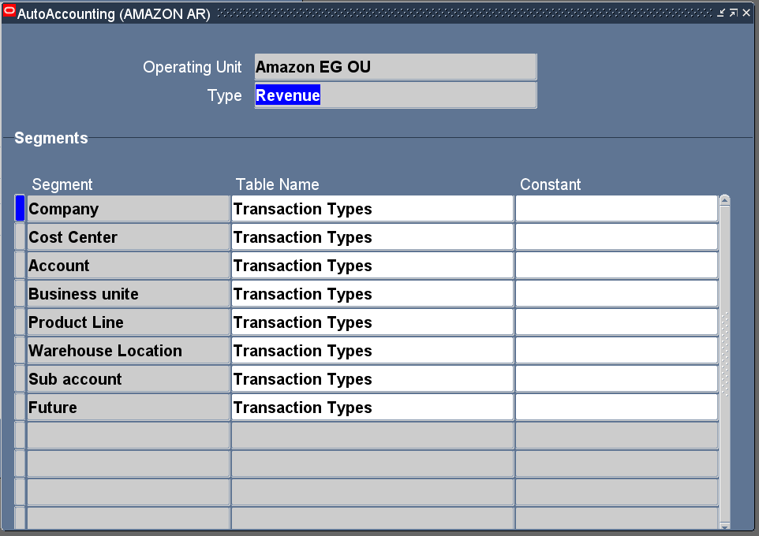
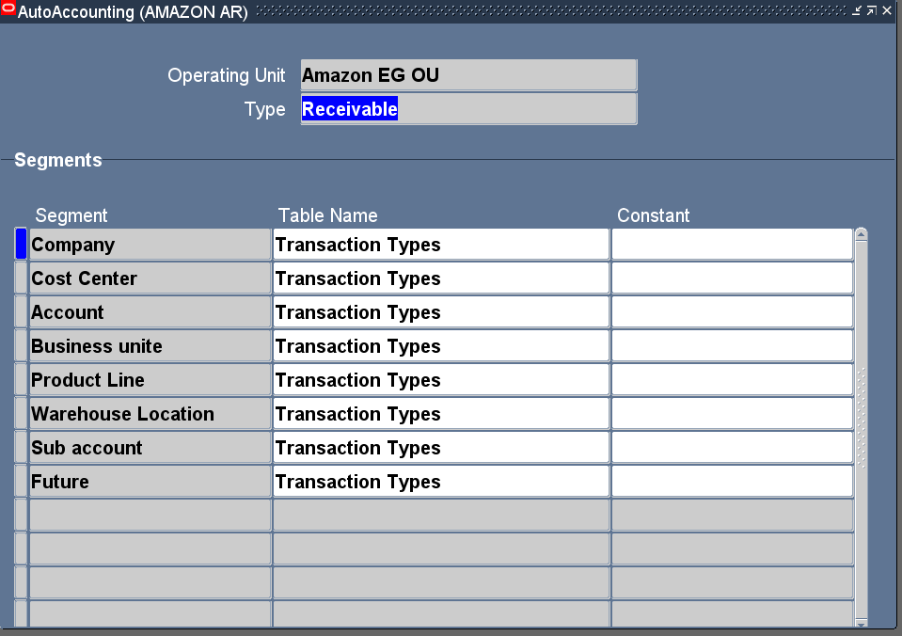
AutoAccounting :
Setup >> Transactions>> AutoAccounting

Slide 29
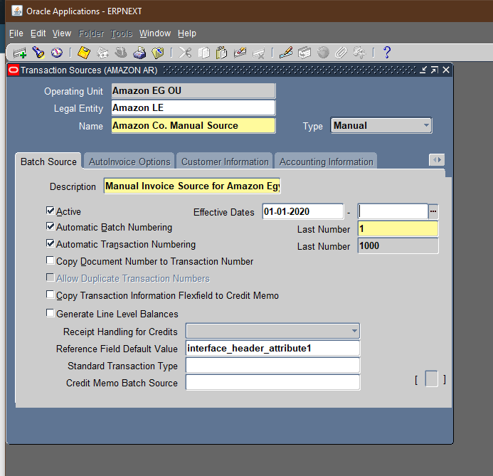
Source:
Setup >> Transactions >> Source

Slide 30
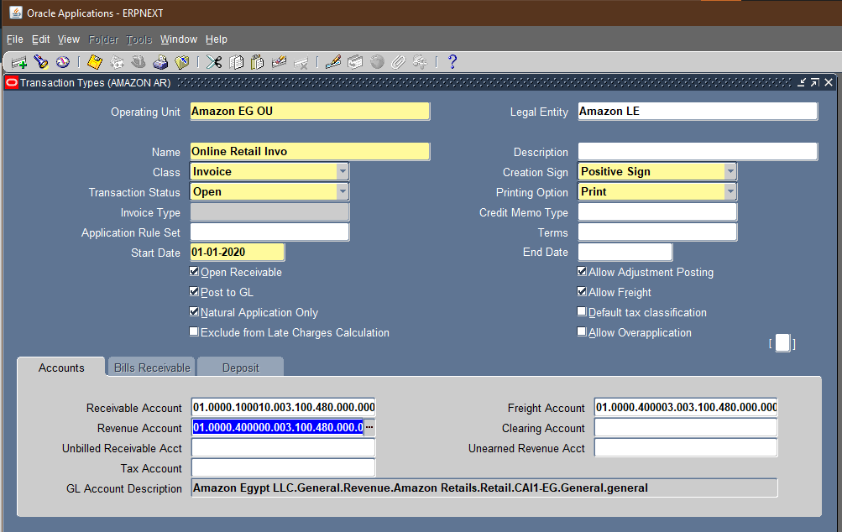
Transaction Types:
Setup >> Transactions >> Transaction Types:
1- Retail Online Invoice

Slide 31
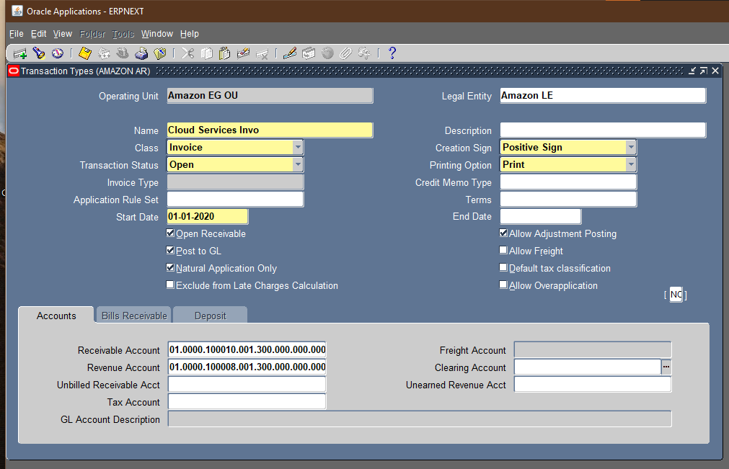

2-Amazon Web Services Invoice

Slide 32
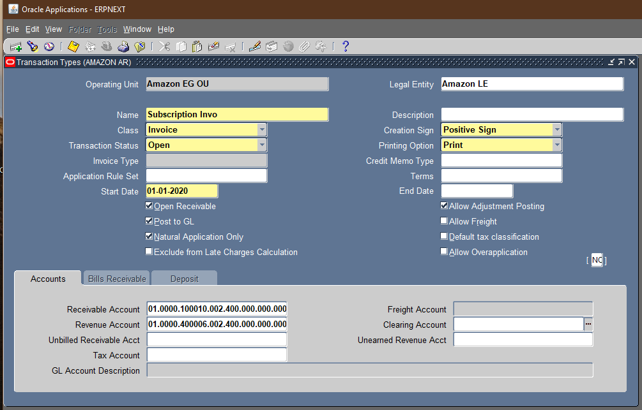
3-Amazon Prime Invoice

Slide 33
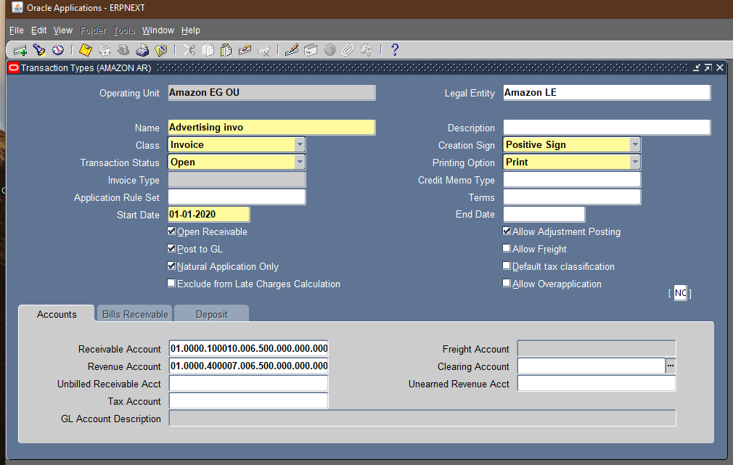
4-Amazon Advertising Invoice

Slide 34
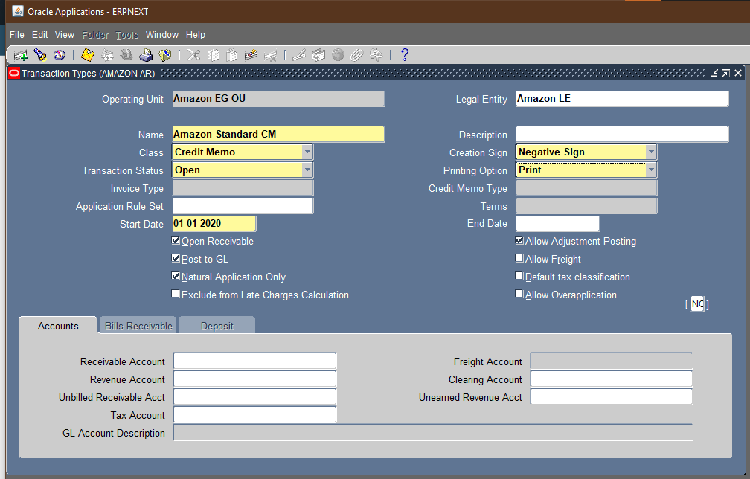
5- Credit Memo

Slide 35
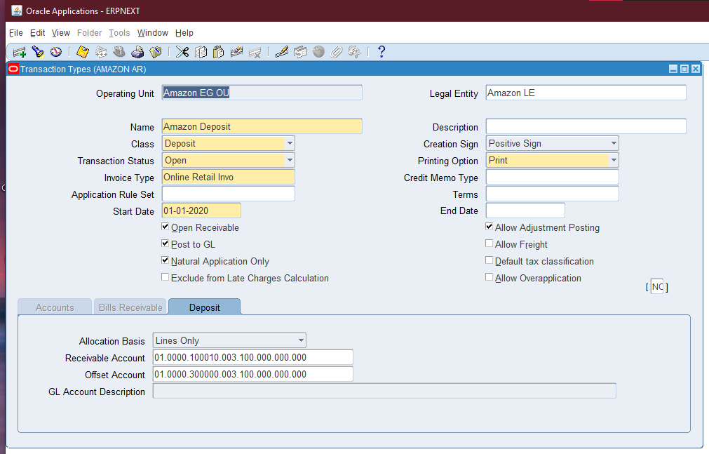
6-Deposit Transaction

Slide 36
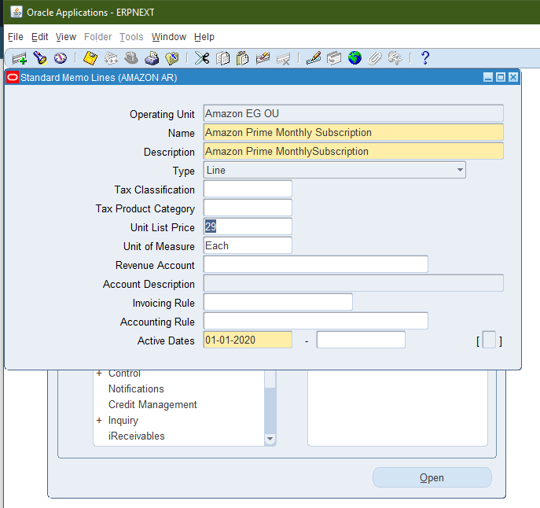
Memo Lines:
Setup>> Transaction>> Memo Lines
1- Amazon Prime Memo Line:

Slide 37
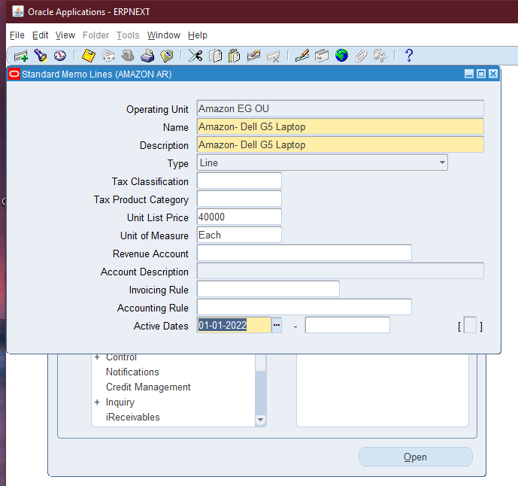
2-Amazon Retail Memo Line:

Slide 38
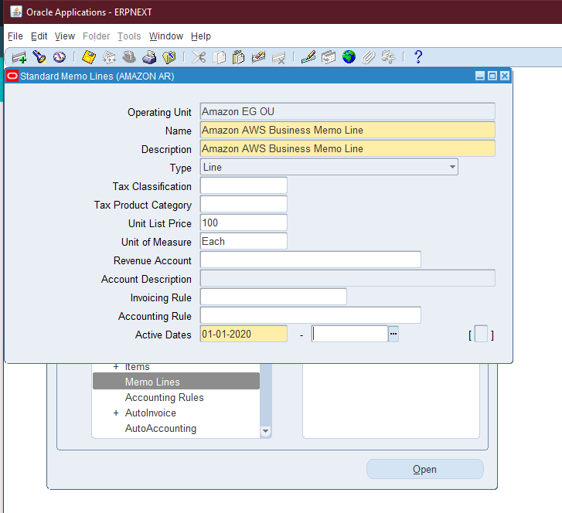
3- Amazon AWS Memo Line:

Slide 39
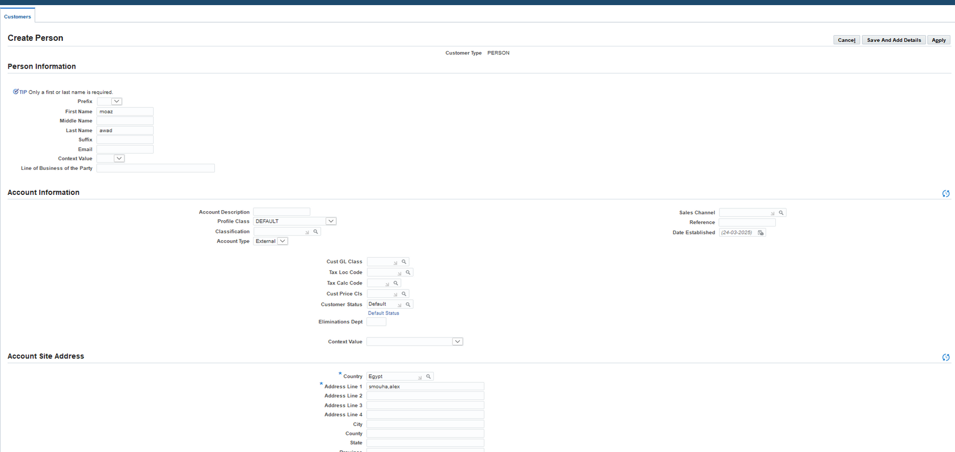
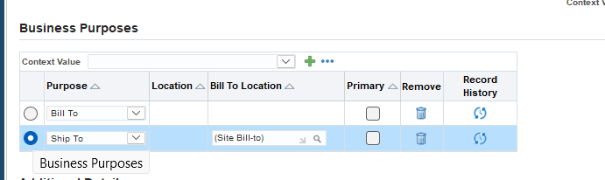
Customer:
1-Create Customer

Slide 40
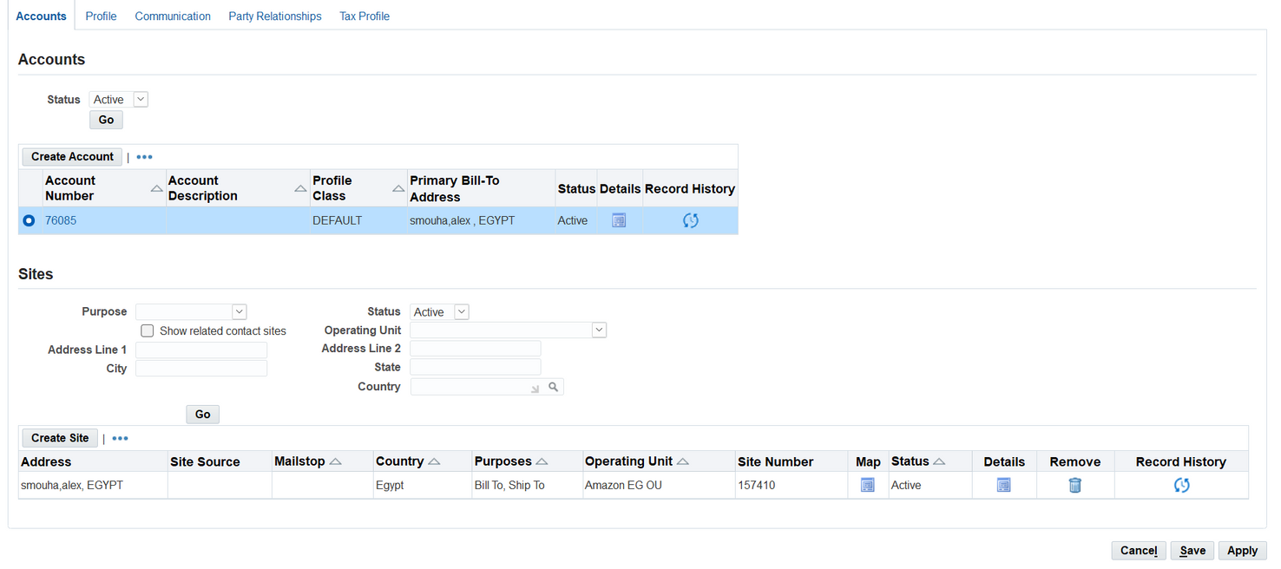
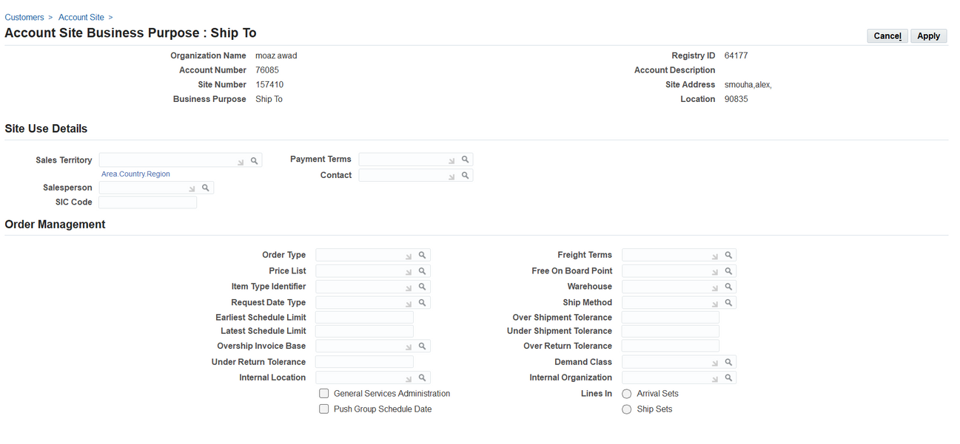
2-Choose Business Purpose

Slide 41
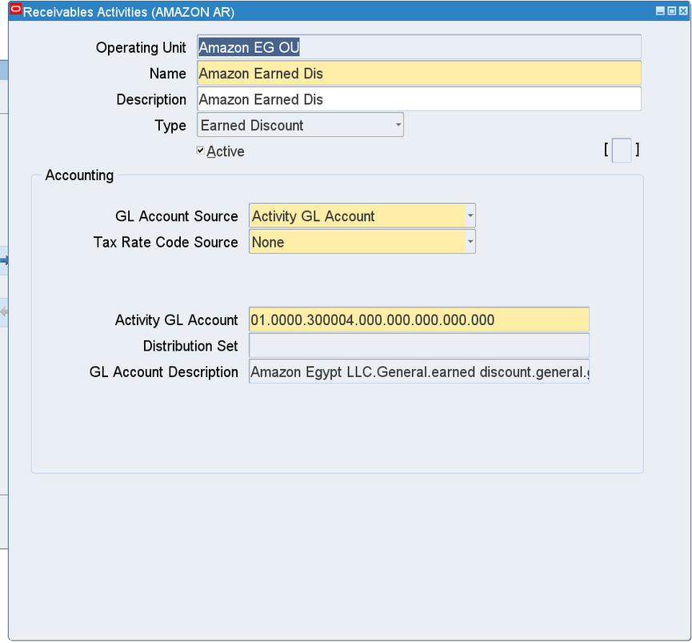
Receivable Activity : earned

Slide 42
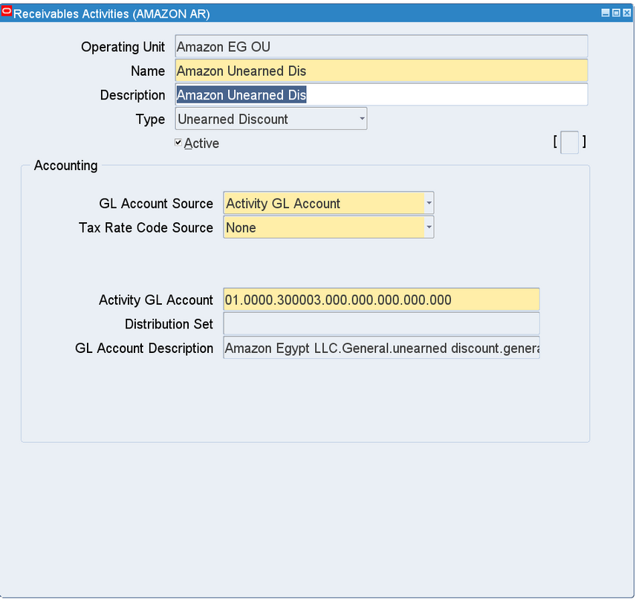
Receivable Activity : unearned

Slide 43
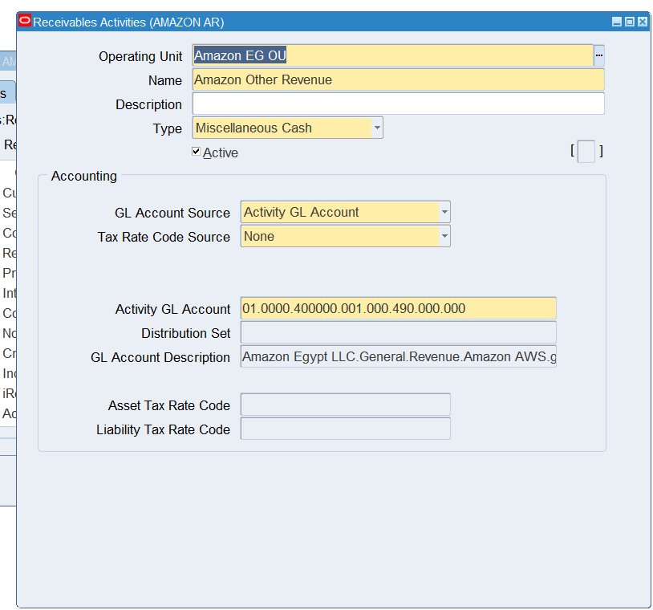
Receivable Activity : miscellenous

Slide 44
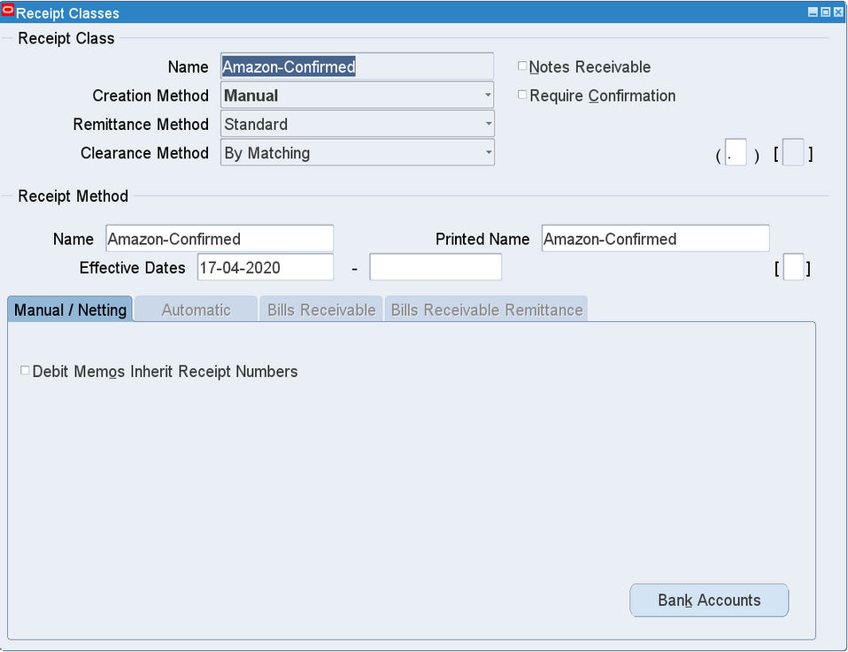
receipt method: confirmed

Slide 45
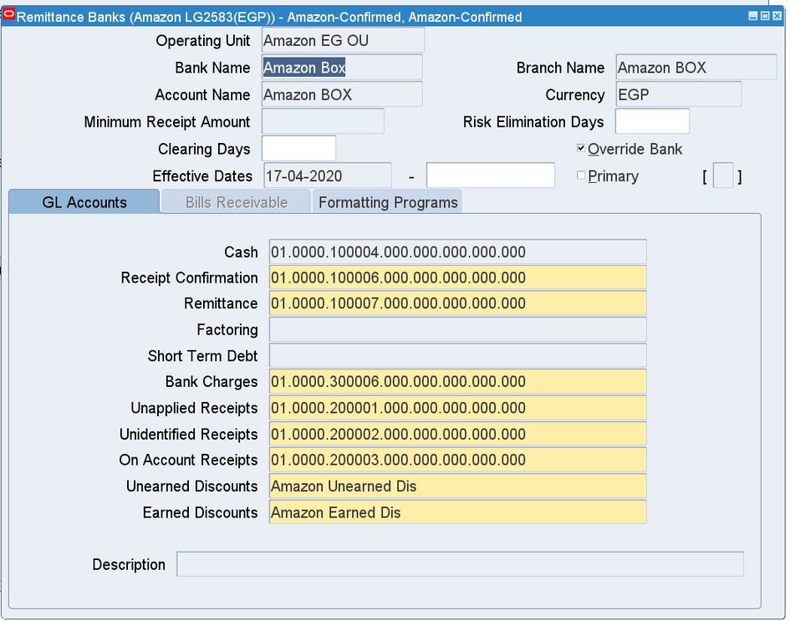
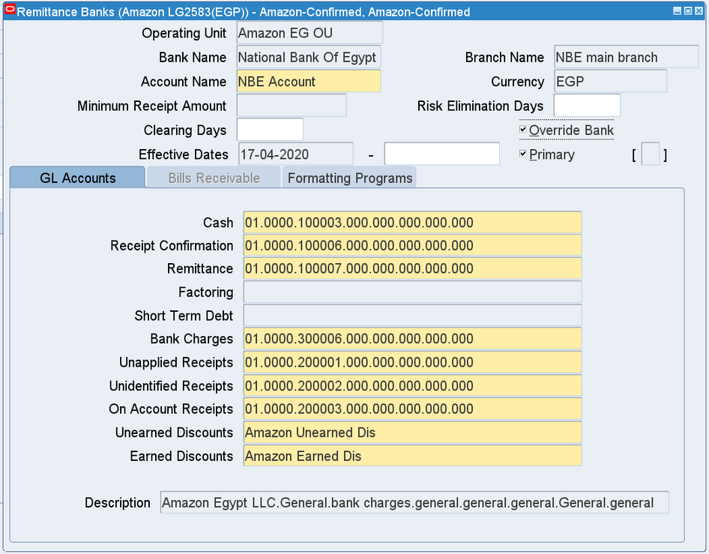
receipt method: confirmed

Slide 46
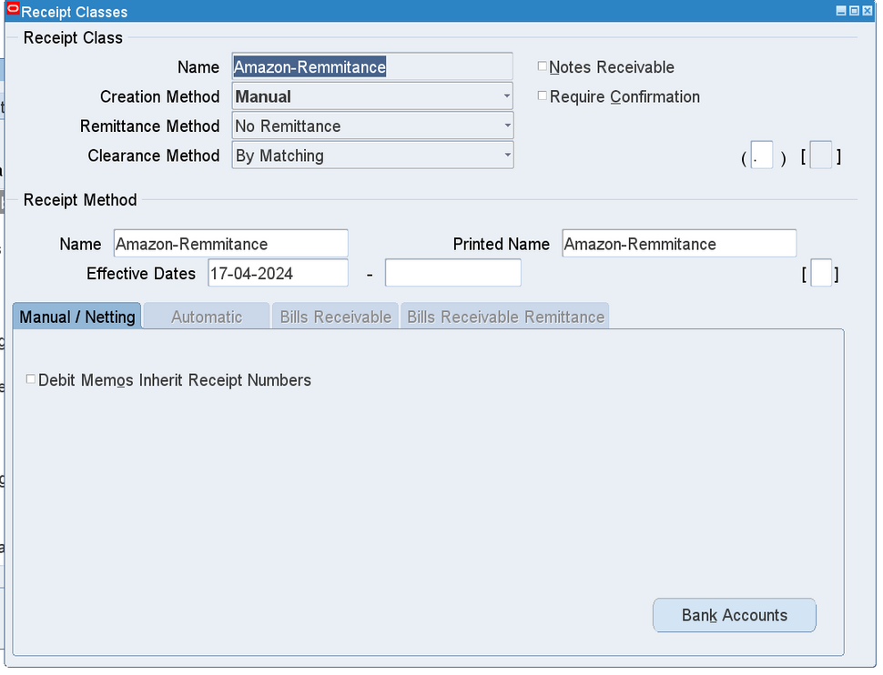
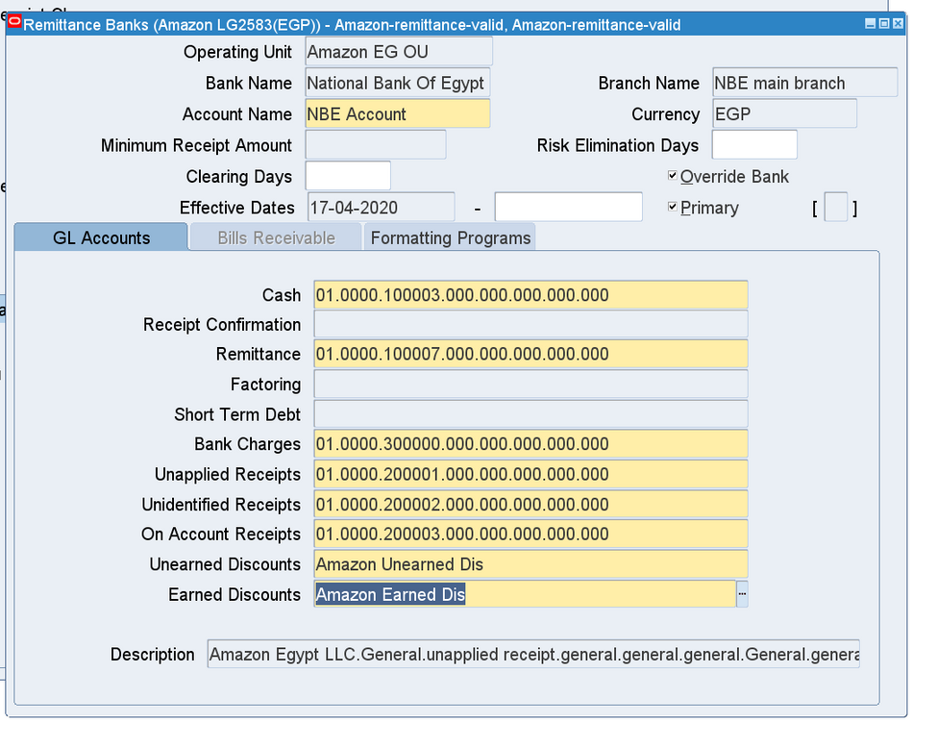
receipt method: remittance

Slide 47
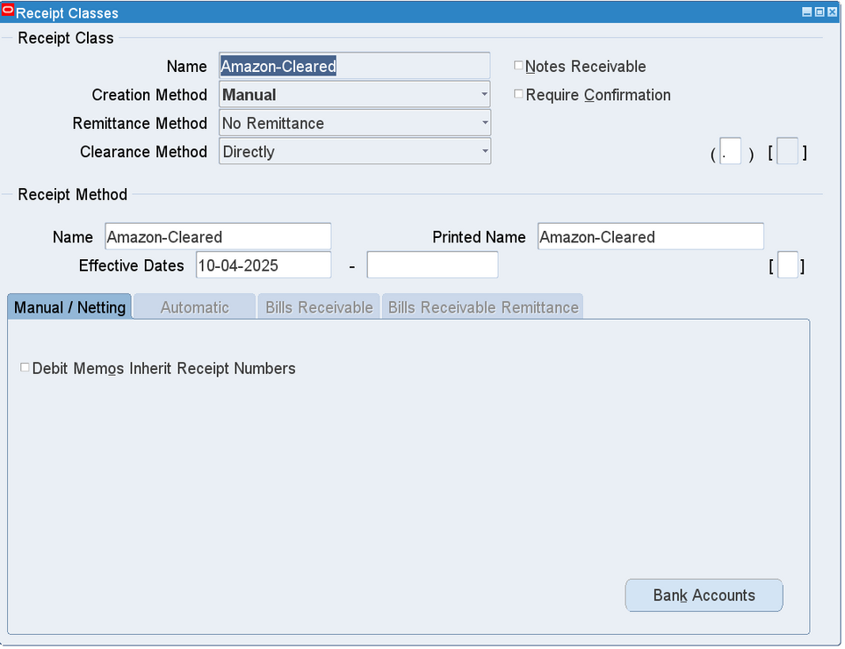
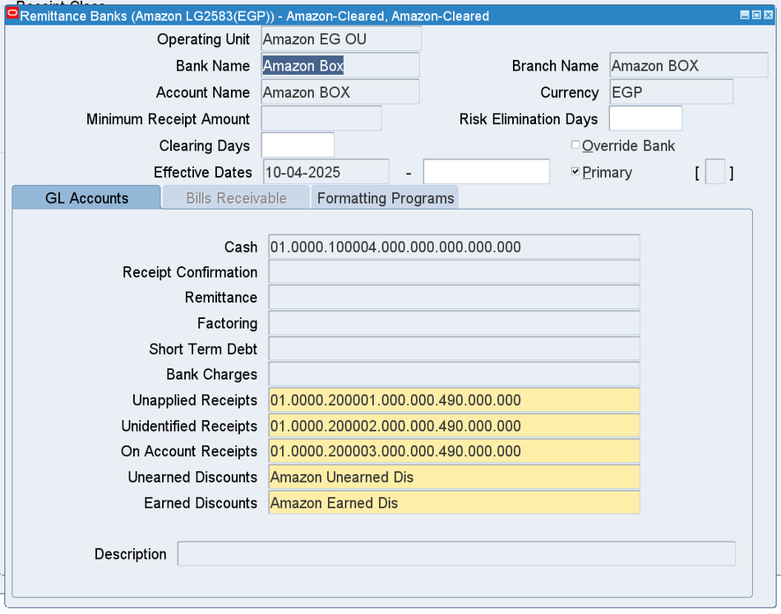
receipt method: Cleared

Slide 48
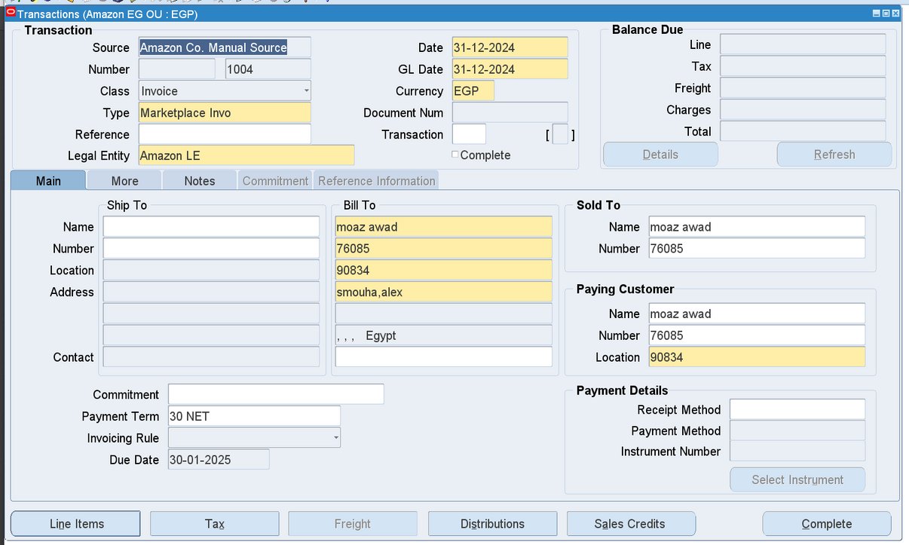
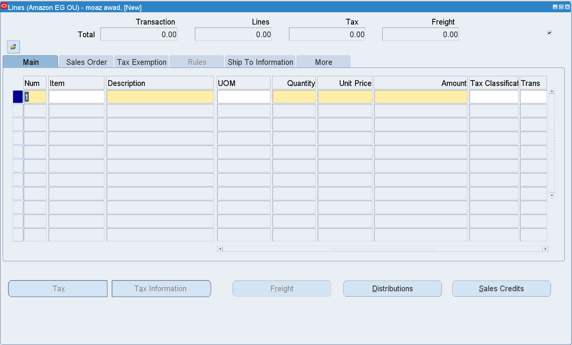
create transaction:
line item

Slide 49
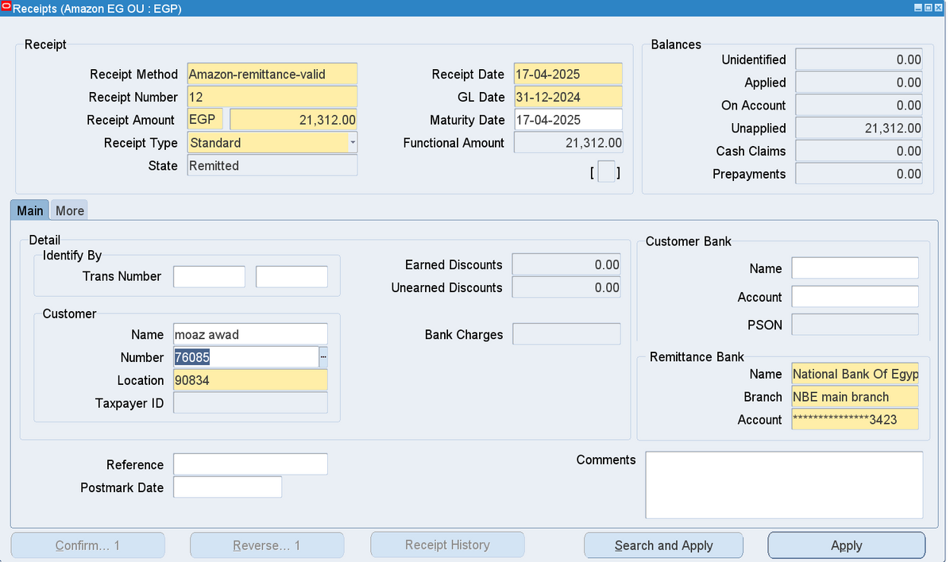
create receipt :

Slide 50
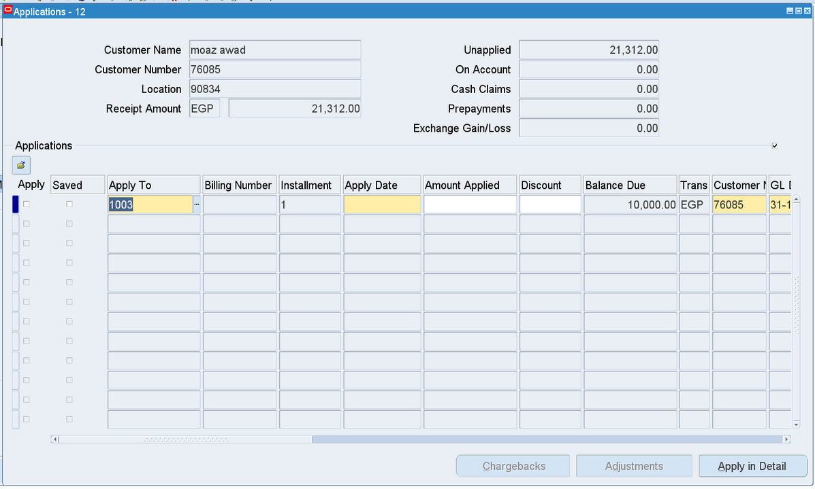
create receipt : apply the receipt

Slide 51

Create Accounting :

Slide 52

Create Accounting :

